Slide 1
Challenges of Gamification in SPI
Software Process Improvement

Slide 2

Agenda
Introduction
Background & Related Work
Methodology
Results
Conclusion

Slide 3



Introduction
Software process improvement (SPI) initiatives have contributed for a long time to the progress of software development. However, the outcome of such initiatives has not always been as effective as expected.

Slide 4
Software Process Improvement
(SPI)

Slide 5


Software Process Improvement (SPI)
SPI in Organizations and companies.
Quality of software development process.
Time Taking and Staff management.
Areas of improvement in Software Development process

Slide 6
SPI in SDLC

Slide 7


Challenges of SPI Initiatives
Motivating Practitioners
One of the biggest challenges faced by SPI initiatives is the motivation of practitioners involved.
Gamification as a Solution
Gamification is a potential solution to the motivation problem in SPI initiatives. However, the effectiveness of gamification in SPI initiatives is still being researched.

Slide 8
How to Change SPI
Process
1
Structure
2
Management
3
People
4

Slide 9

Ways To Motivate
Receiving Rewards
Top-down commitment (Senior-management support)
Visible success
Considering Personality Types

Slide 10
Gamification

Slide 11

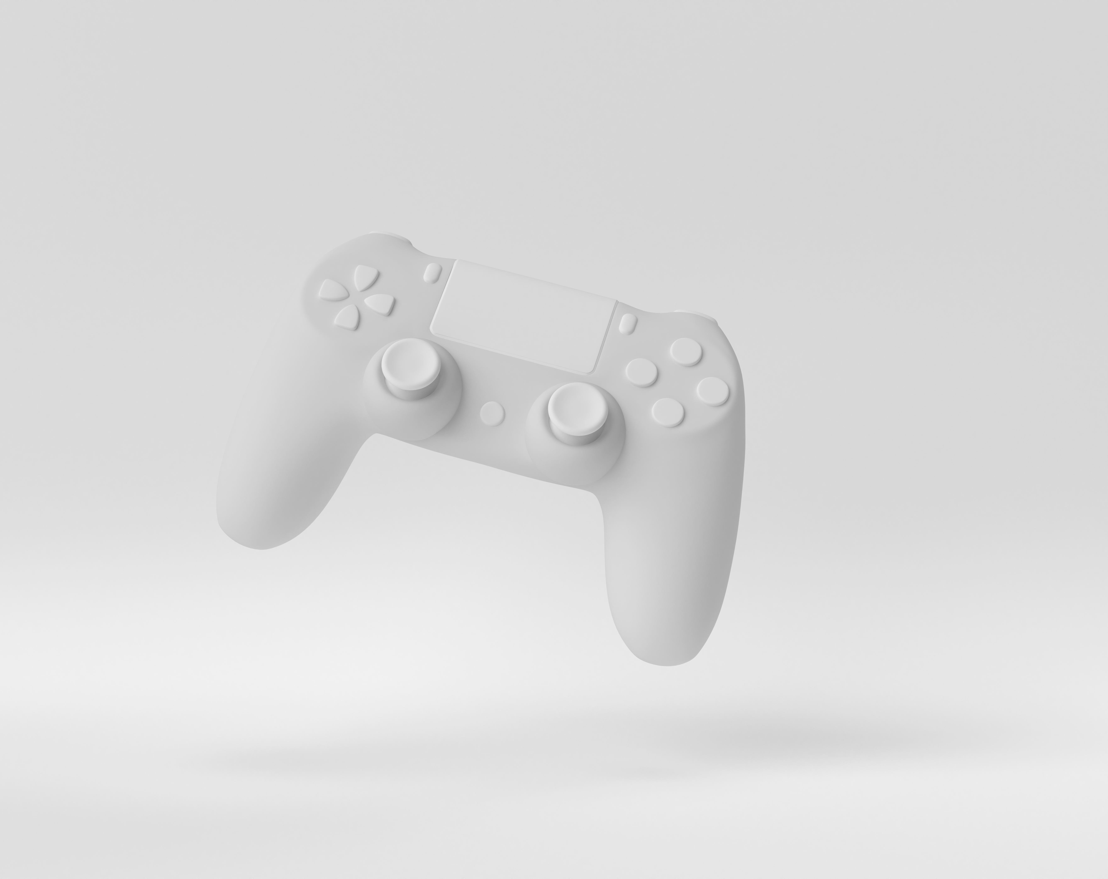
Gamification
Gamification is defined as the application of game design and elements in nongame contexts.
It is Used as a motivational technique to encourage and facilitate new behaviors.
It initially emerged in the business and marketing sectors implementing techniques such as loyalty cards and stamp books for increased customer loyalty and retention.

Slide 12
Methodology

Slide 13
Research and studies for methodology
A systematic mapping study was performed to identify the main challenges of integrating gamification and Software Process Improvement (SPI).

Slide 14
Research Questions
ID | Questions
RQ1 | What issues of SPI have been addressed by gamification?
RQ2 | How has gamification been implemented in SPI? RQ2.1. What gamification processes or approaches, if any, have been followed to incorporate gamification in SPI? RQ2.2. What gamification elements/components have been used? RQ2.3. What kind of tools/instruments have been used to implement the gamified solution?
RQ3 | What is the evidential impact of gamification on SPI? What aspects of SPI have been affected or improved?

Slide 15
Search Process and Study Selection
The search process was designed to achieve the maximum level of coverage.
The search string was designed as comprehensive as possible. No extra keywords were used other then “gamification” and “software process improvement”.
The selection of primary studies was done through two screening stages: reading of titles and abstracts to identify potentially relevant studies, and reading the full text to make a decision of inclusion or exclusion.

Slide 16
Data extraction and analysis
A data extraction form was designed to capture the necessary data for answering the research questions.
The key fields were:
Research type
The objective of applying gamification in SPI
Gamification approach
Gamification elements
Type of implementation
Gamification impact.

Slide 17
Results

Slide 18
General Results
Introduction of Gamification in SPI: The first primary study introducing gamification in Software Process Improvement (SPI) was in 2012, proposing to use gamification as a solution in the context of SPICE.

Slide 19
General Results
Peak of Validation Studies: The year 2016 shows a peak with three validation studies conducted to investigate the impact of gamification on SPI.

Slide 20
Peak of Validation Studies
1st validation study was done by Yilmaz and O'Connor and they performed a validation study by surveying software practitioners which involved adopting a gamified Scrumban process to improve the development process.
2nd validation study was done by Ruiz, and Calderón and they conducted a pilot study to assess the validity of their own gamification proposal using a questionnaire.
Last was done by Herranz who employed a qualitative research through interviews that involved experts from gamification and SPI to further assess the validity and relevance.

Slide 21
General Results
Reflection on Gamification Experience: In 2018, an experience paper was published reflecting on the gamification experience with Gamiware, discussing the success factors, or enablers, of gamification initiatives in SPI.

Slide 22
RQ1—what issues of SPI have been addressed by gamification?
Engagement and Motivation
Commitment
Communication
All primary studies highlight motivation as a key challenge in Software Process Improvement (SPI) initiatives.
Constant and firm commitment towards SPI is crucial to avoid costly waste of effort and failure.
Clear visibility and feedback of goals and progress are essential in SPI initiatives.

Slide 23
RQ2—how has gamification been implemented in SPI?
Approaches to Gamify SPI
Tools and Platforms used
Game components in non-game context
Most primary studies follow the “6D” gamification framework of Werbach and Hunter. Primary study carried out the gamification of SPI show that there is no rule of thumb when it comes to applying gamification in SPI.
Badges were found to be the most frequently used game component, integrated in all primary studies.
Progress bars and leaderboards, were used to provide feedback to developers about their progress in a certain task.
Gamification platform “Gamiware”.
Two tools to implement their gamification strategy:
OpenBadgesUCA
GamAnalyze

Slide 24
6D Guidelines
The "6D" gamification framework is a six-step process for developing a gamified system. The steps are:
Define
Delineate
Describe
Devise
Don't forget the fun
Deploy

Slide 25
RQ3—what is the evidential impact of gamification on SPI?
Increased Motivation
Complexity of Gamiware
Enhanced Knowledge and Performance
Participants reported that their motivation level increased with regard to performing Software Process Improvement (SPI) using gamification.
The author indented to use Gamiware as SPI for a small IT company but found that the tool would put them in additional complexity. So, they used an application named Gitlab.
There was an increase in knowledge and level of understanding about the software development process, and improved performance among software developers.

Slide 26
Challenges in Gamification of SPI

Slide 27


Challenges
Defining the target audience of gamifying SPI
Defining the expected outcome from gamifying SPI
Designing different gamification strategies for different organizational roles

Slide 28

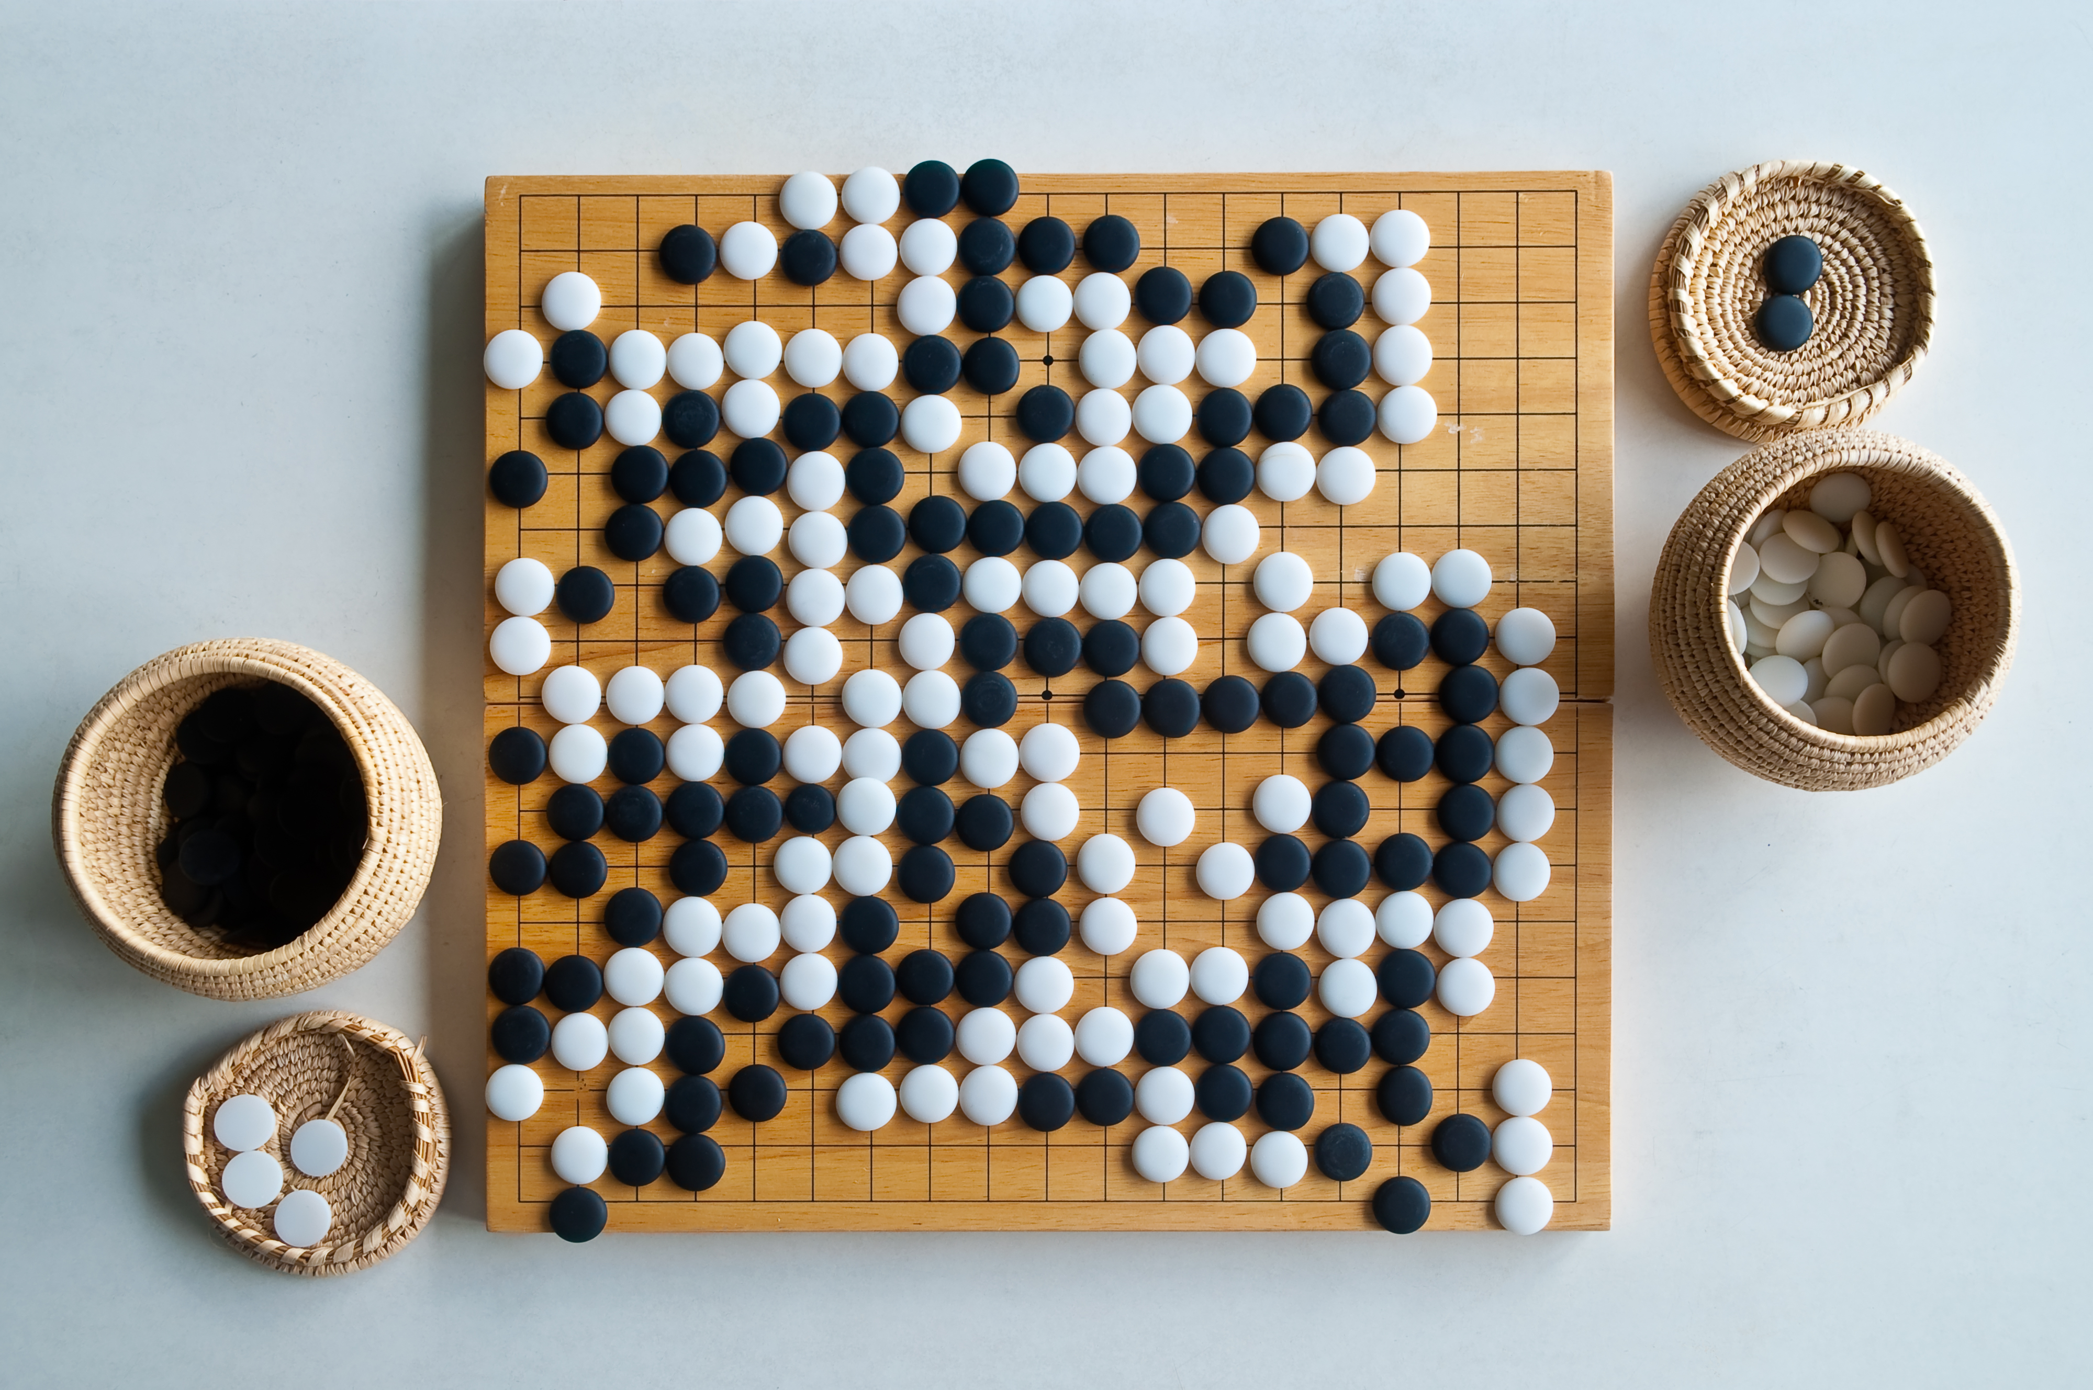
Challenges - Cont
Choosing the appropriate approach to implement gamification
Lack of empirical data
Managing the additional effort introduced by gamifying SPI

Slide 29
Target Audience
You need to decide who in the company should be involved. Should it be just the programmers, or also the managers, or maybe even the top executives?

Slide 30
Target Goals
So, it's crucial to set clear goals and expectations when using gamification to make sure everyone knows what they're working towards.

Slide 31
Designing different Strategies
This can be challenging because it requires careful planning and customization to ensure that everyone benefits from the gamification process.

Slide 32
Choosing Appropriate Approach
here you have to decide when to give reward, how to use them, and when to use them

Slide 33
Lack of empirical data
Even with the information provided in primary studies about the effectiveness of gamification in SPI, the data are hard to generalize given that the majority of experiments were not conducted in a real organizational setting

Slide 34
Managing Additional Efforts:
Gamifying a process should not impose a significant change that enforces learning about gamification or completely transforming the way people work
Github to Gamiware

Slide 35
CONCULUSION

Slide 36


WHAT is SPI
Same Like BPR but for Software Buisnesses
Goal to improve whole Software development Process
Challenges of SPI
Motifvating People
Biggest Challenge
Gamification as a Solution
Better than other soluions
Reason for Good
Reason for Bad

Slide 37
To Change SPI
Process
Structure
Management
People (IMPORTANT)
Ways to Motivate
Recving Rewards
Incentives
Bonuses
Visible Success
How much work they done
How much work is left
Leaderboards

Slide 38
Gamification
A Motivational Technique
To Encourage and Facilitate new behaviours
Implementing Gamification in SPI
Issues To Resolve
Engagement & Motivation (of people)
Comitment (towards goals)
Communication (gap)
Impact we achive
Increased Motivation (of people)
Use of Tool (Gamiware -> Gitlab)
Enhanced Knowledge & Performance

Slide 39
Challenges in Gamification of SPI
Target Audience
Target Goal
Desgining Diffrent Strategies
Chosing Apprpirate Goal
One Sentence
To implement Gamification in SPI, it requires a lot of Depth-Analysis and Preperation

Slide 40

The way to get started is to quit talking and begin doing.
Walt Disney

Slide 41
Thank you
Presentation by Group 2

